Slide 1

Sentiment Analysis of Twitter Data on the Ukraine Russia War
Exploring Public Opinion Dynamics
B. Hemanth Chowdary - 192211206
K. Bharath Chandra - 192211298
V. Khyathi Keerthana - 192211631

Slide 2

TABLE OF CONTENTS
Introduction to Sentiment Analysis
Objective of the Research
Methodology
Results

Slide 3
INTRODUCTION
Background: The Russia-Ukraine conflict has sparked intense global discourse, with divergent opinions and emotions prevalent across social media platforms.
Significance of Twitter: Twitter serves as a prominent platform for real-time expression, making it an ideal source for studying public sentiment during contentious events.
Objective: This project aims to conduct sentiment analysis on Twitter data related to the Russia-Ukraine conflict from January to June 2022.
Implications: Insights derived from this analysis hold implications for policymakers, media professionals, and researchers, contributing to a deeper understanding of public opinion dynamics during geopolitical conflicts.

Slide 4

Gathered 30,000 tweets on Russia-Ukraine conflict using relevant hashtags and keywords from Twitter API or third-party sources.
Sentiment Analysis Process
Data Collection
STEP 1
Data Cleaning and Preprocessing
Removed Twitter handles, URLs, special characters, and standardized text formats for consistency and analysis readiness.
STEP 2
Sentiment Analysis using VADER
Utilized VADER tool for sentiment analysis, assigning compound scores to tweets representing overall sentiment polarity.
STEP 3
Analysis and Visualization
Analyzed sentiment distribution and trends, visualizing results through graphs, word clouds, and kernel density estimates for effective communication.
STEP 4

Slide 5

DATASET DESCRIPTION
Dataset: 30,000 tweets
Timeframe: January to June 2022
Keywords: Related to Russia-Ukraine conflict

Slide 6




OUR ANALYSIS PHILOSOPHY
Insights for Decision-Making
Understanding Public Sentiment
Contribution to Knowledge

Slide 7
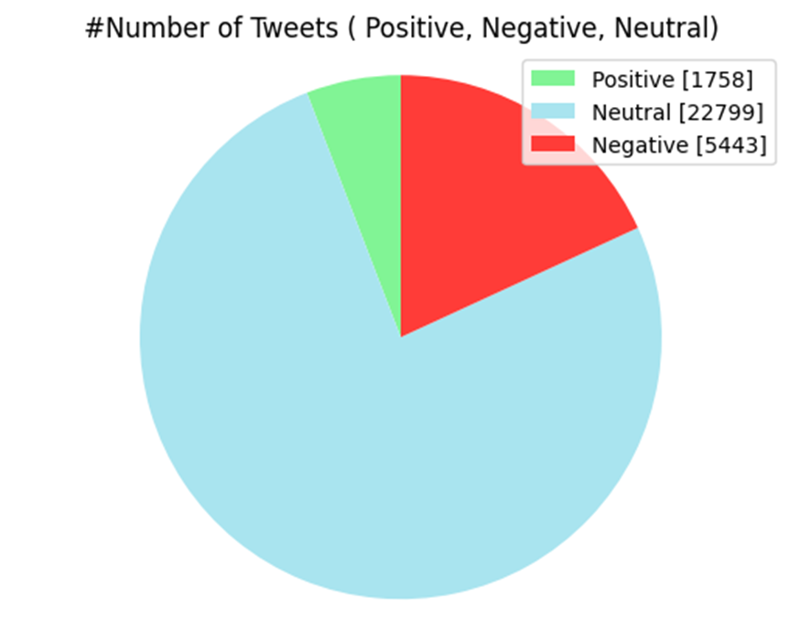
RESULTS
The above output presents a graphical representation of the distribution of tweets across positive, negative, and neutral sentiment categories. It provides a visual understanding of the proportion of tweets expressing positive, negative, and neutral sentiments towards the Russia-Ukraine conflict on Twitter.

Slide 8
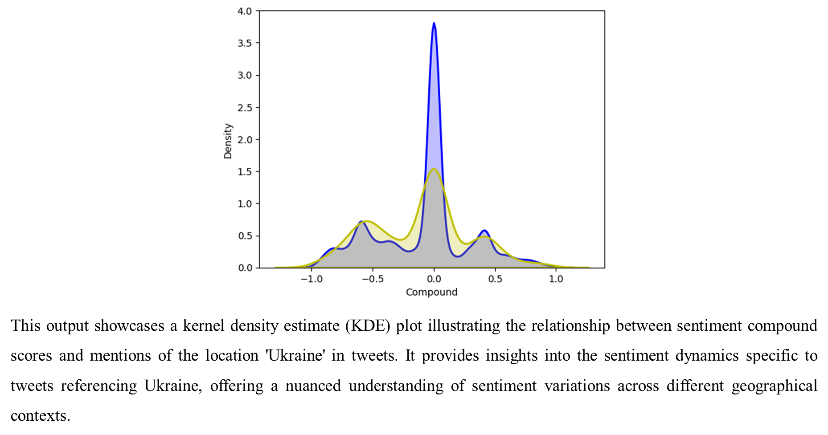

Slide 9
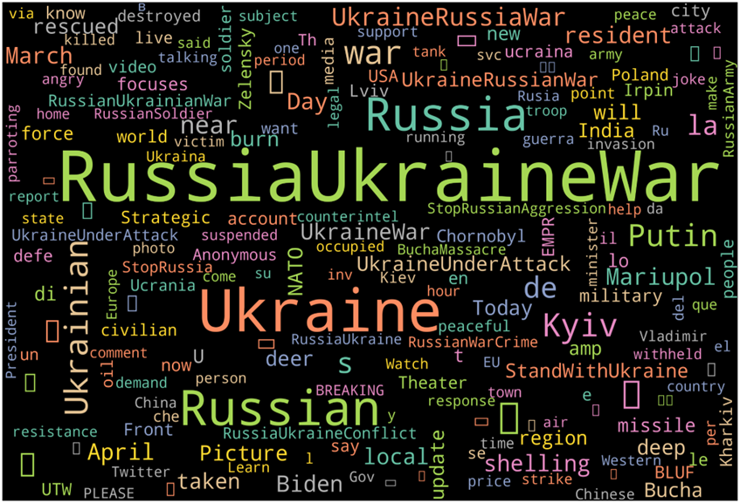
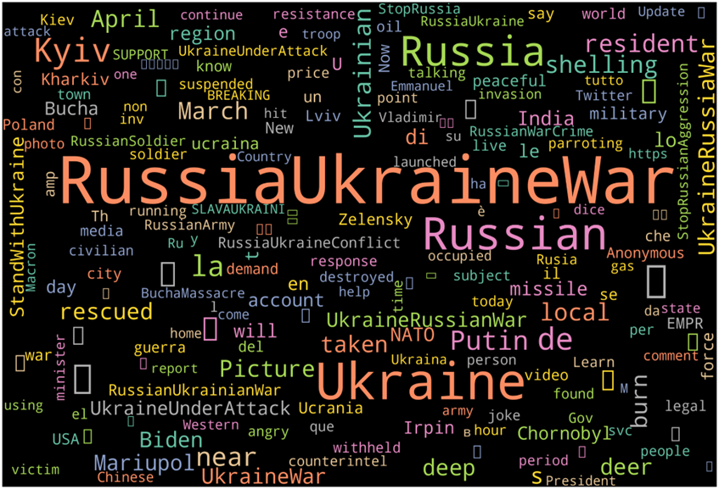
WordCloud ANALYSIS
WordCloud of mostly used words in the overall tweets:
WordCloud of mostly used words in the overall tweets:

Slide 10
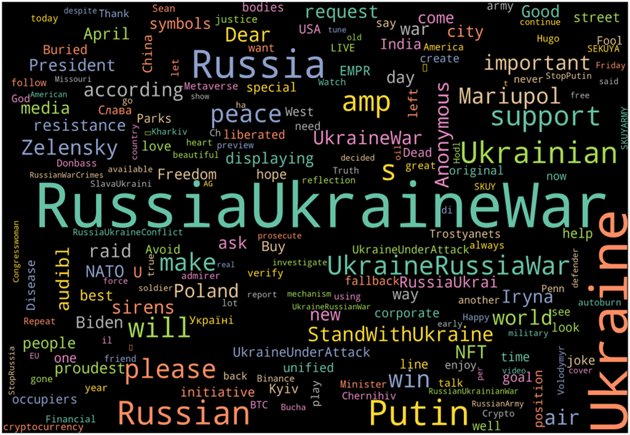
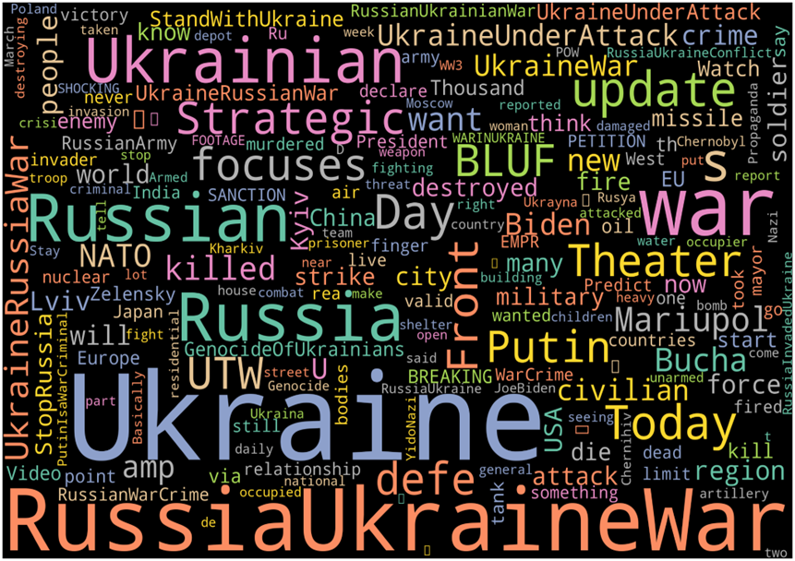
WordCloud ANALYSIS
WordCloud of mostly used words in the positive tweets:
WordCloud of mostly used words in the Negative tweets:

Slide 11


